Slide 1



FPC - Giving

Slide 2
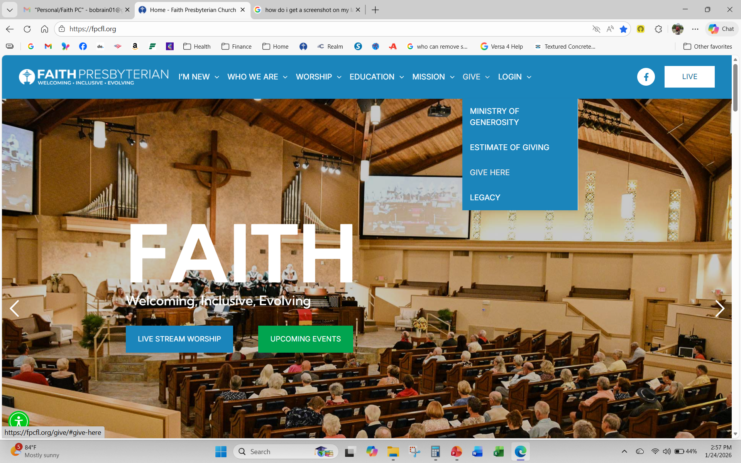


Giving through Faith Website (https://fpcfl.org) – directs you to the Realm Giving Screen

Slide 3
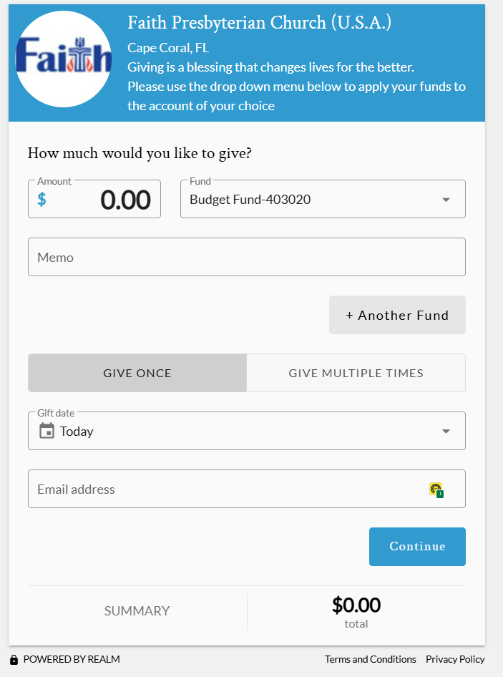
Giving Screen from Realm
Enter amount (must be greater than $3)
Select Fund (drop down list)
Memo (optional) (e.g., Feb tithing)
+ Another Fund – fund additional account(s)
Give Once –or- Recurring
Confirm Gift date (today or future date)
Enter Email address
Select continue

Slide 4
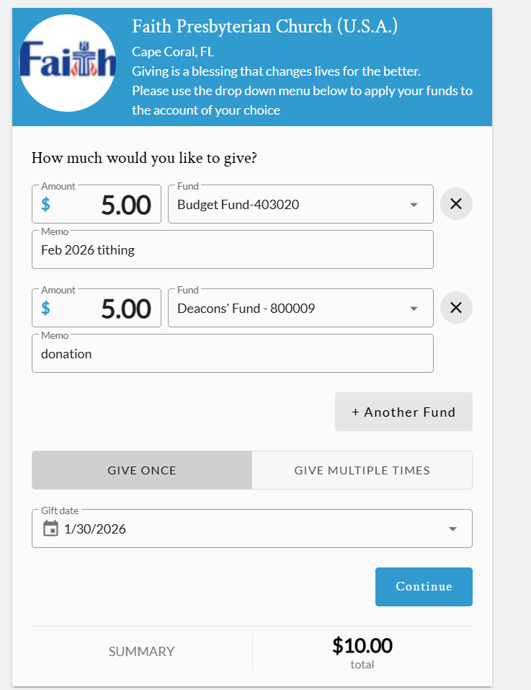





Example of multi-fund giving
Enter information for multiple fund giving
Memo (optional)
+ Another Fund if applicable
Give Once –or- Recurring
Confirm or Change Gift date
Select Continue

Slide 5
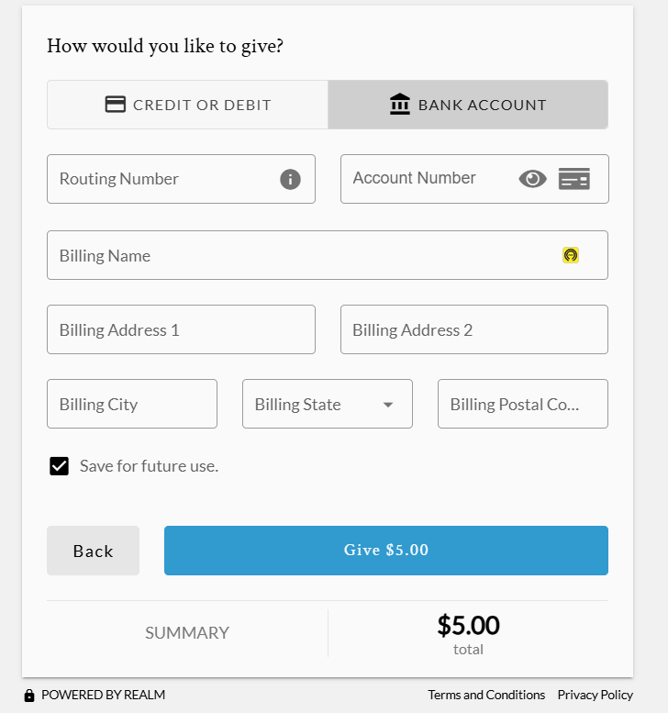
Set-Up Payment from Bank Account
Pay from checking or savings account
Enter Routing and Account Numbers
Enter Billing Name/Address
Check (√) to save the bank information for future giving
Back to prior screen OR select the GIVE button

Slide 6
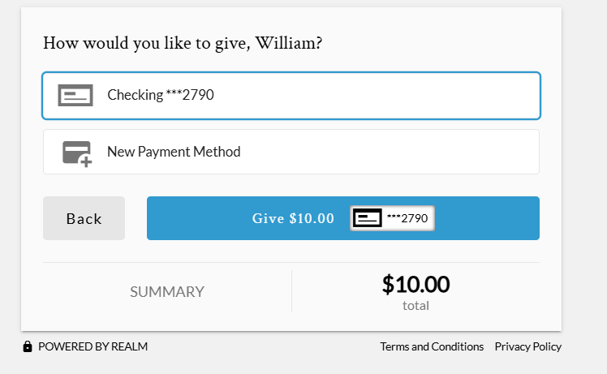
Identify source of funding
Example of Funding via checking account
Offers option to add a New Payment Method
Back to prior screen OR select the GIVE button

Slide 7
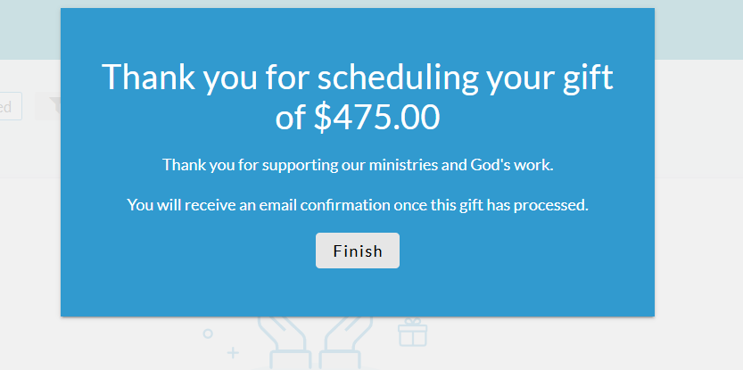
Submitted donation via Checking Account
Acknowledgement of scheduled donation
Email confirmation will be sent once gift has been received
Select FINISH

Slide 8
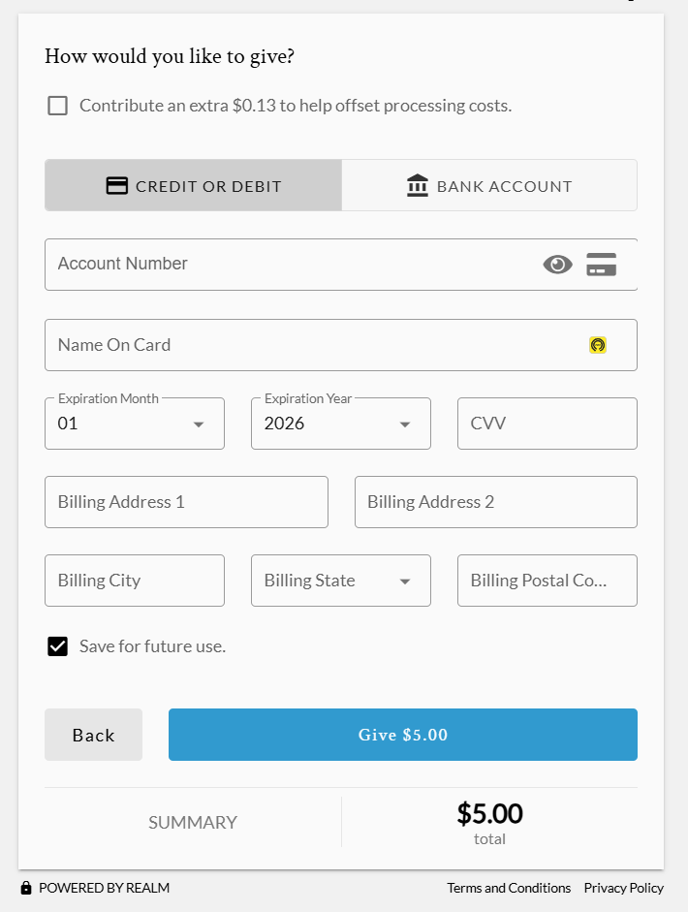
Set-Up Payment from Credit or Debit Card
Check (√) if you wish to pay the processing fee
- charge is calculated based off the gift amount - donor is credited for full donation + fee
If the processing fee is not covered, the church absorbs the fee. Donor is credited for their full donation amount
Enter card details, name, address info
Check (√) whether you want to save the card information for future giving
Back to prior screen OR select GIVE blue button

Slide 9
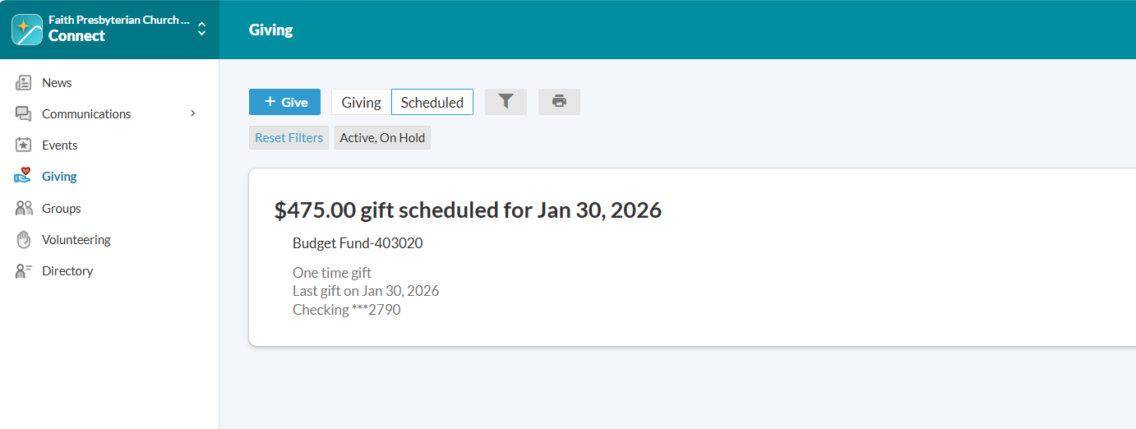

Future-Dated Gift
Realm offers a view of scheduled gifts with their giving date

Slide 10
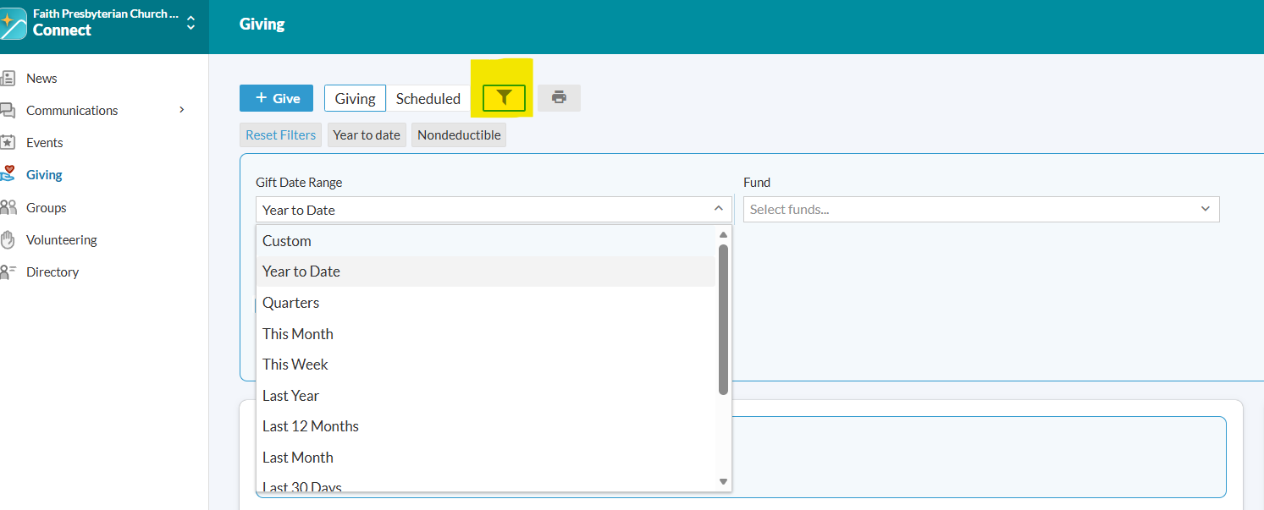


Customize a view of your giving
From the Giving screen you can select the filter icon to create a view of your giving.
Select the date range you wish to view (multiple options from a drop-down list as shown)
Select specific Fund(s) or leave as is (will default to Budget Fund)
Once you’ve generated a view, you can press the printer icon to print your view.

Slide 11
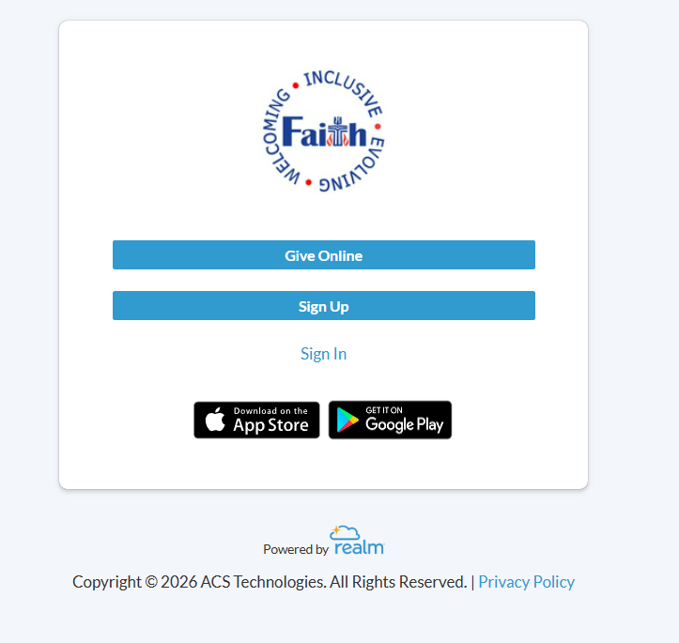
Giving through Realm Log In
New members receive a packet that includes info about Realm.
New member will receive an email with a link to create their Realm login.
Occasionally, someone tries to access Realm via Faith’s website. They enter their email and submit a request for an account.
An administrator determines whether request is valid and will subsequently send out email with link to access Realm OR advise of a denial.

Slide 12
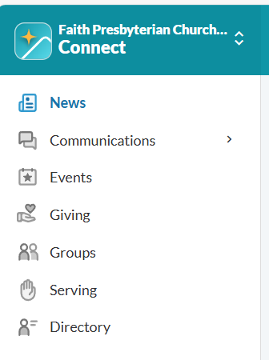

Giving through Realm
Once you have successfully logged into Realm, you are presented this menu.
After selecting the ‘Giving’ option, you will navigate through the screens/options already shown.

Slide 13
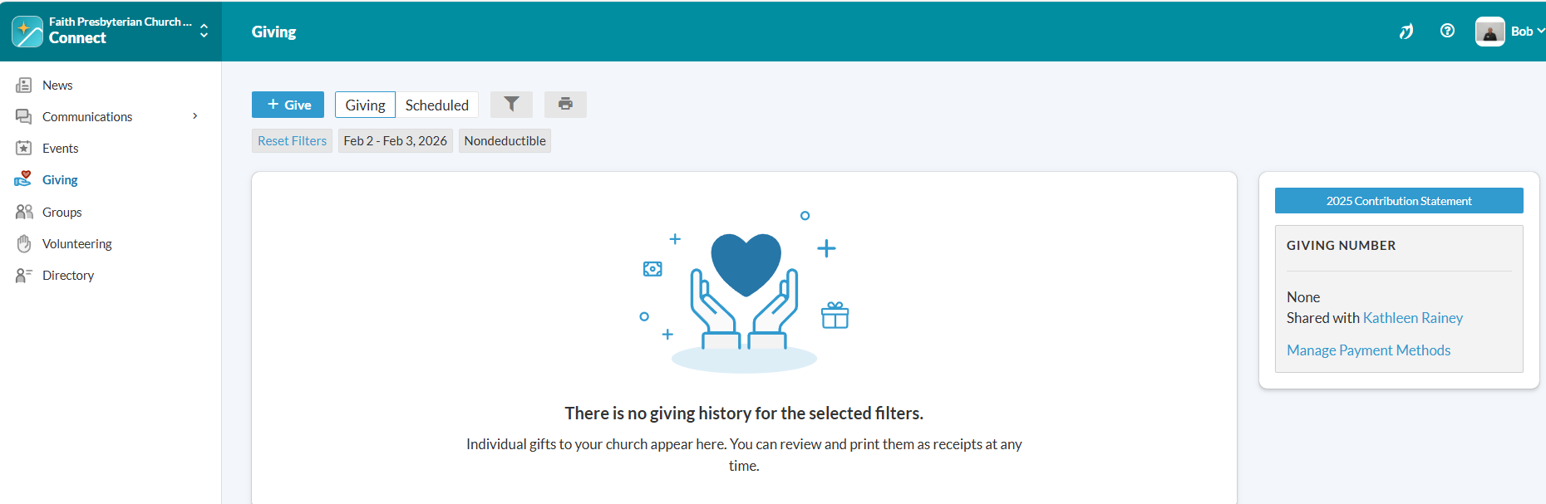

Access Year End Giving Statement in Realm
In the beginning of February, a button becomes available on the Giving screen to view/print your annual giving statement for the prior year.

Slide 14
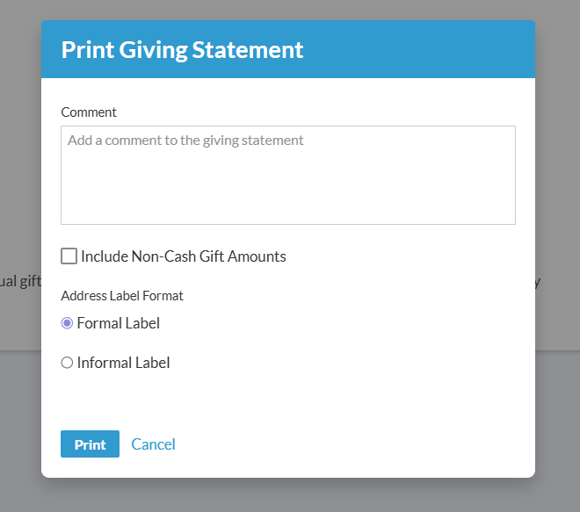
Print Annual Giving Statement
Comments added will appear on generated statement (e.g. Smith Family 2025 Giving)
Check (√) if you wish to show non-cash gifts on statement
Use Formal Label (default)
Print or Cancel

Slide 15
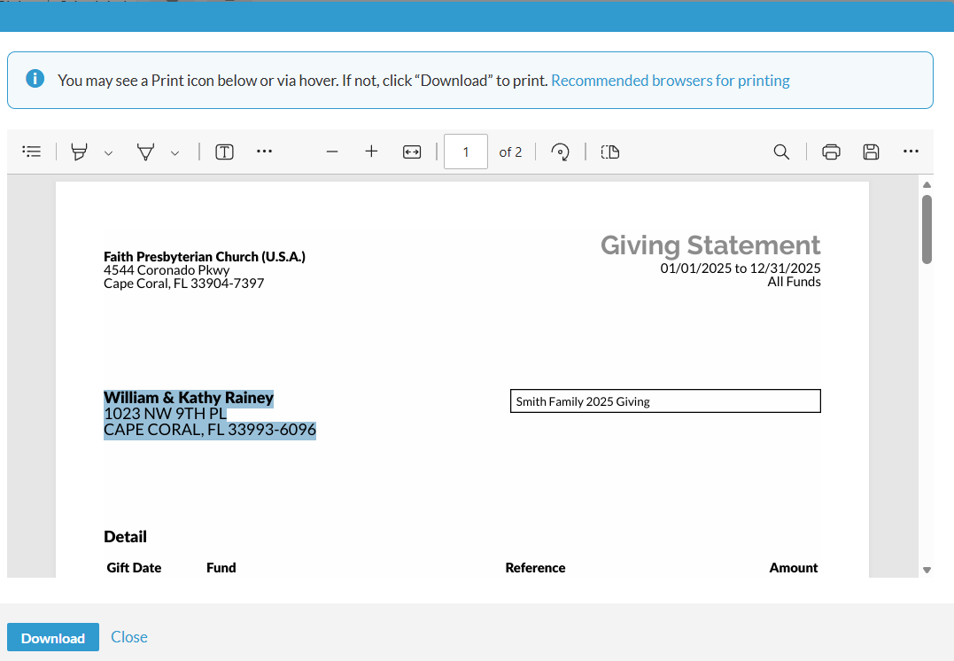

Annual Giving Report
Realm will generate your annual giving statement
You can elect to print and/or download the report

